Slide 1
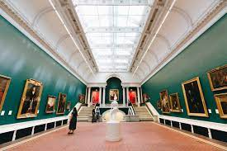
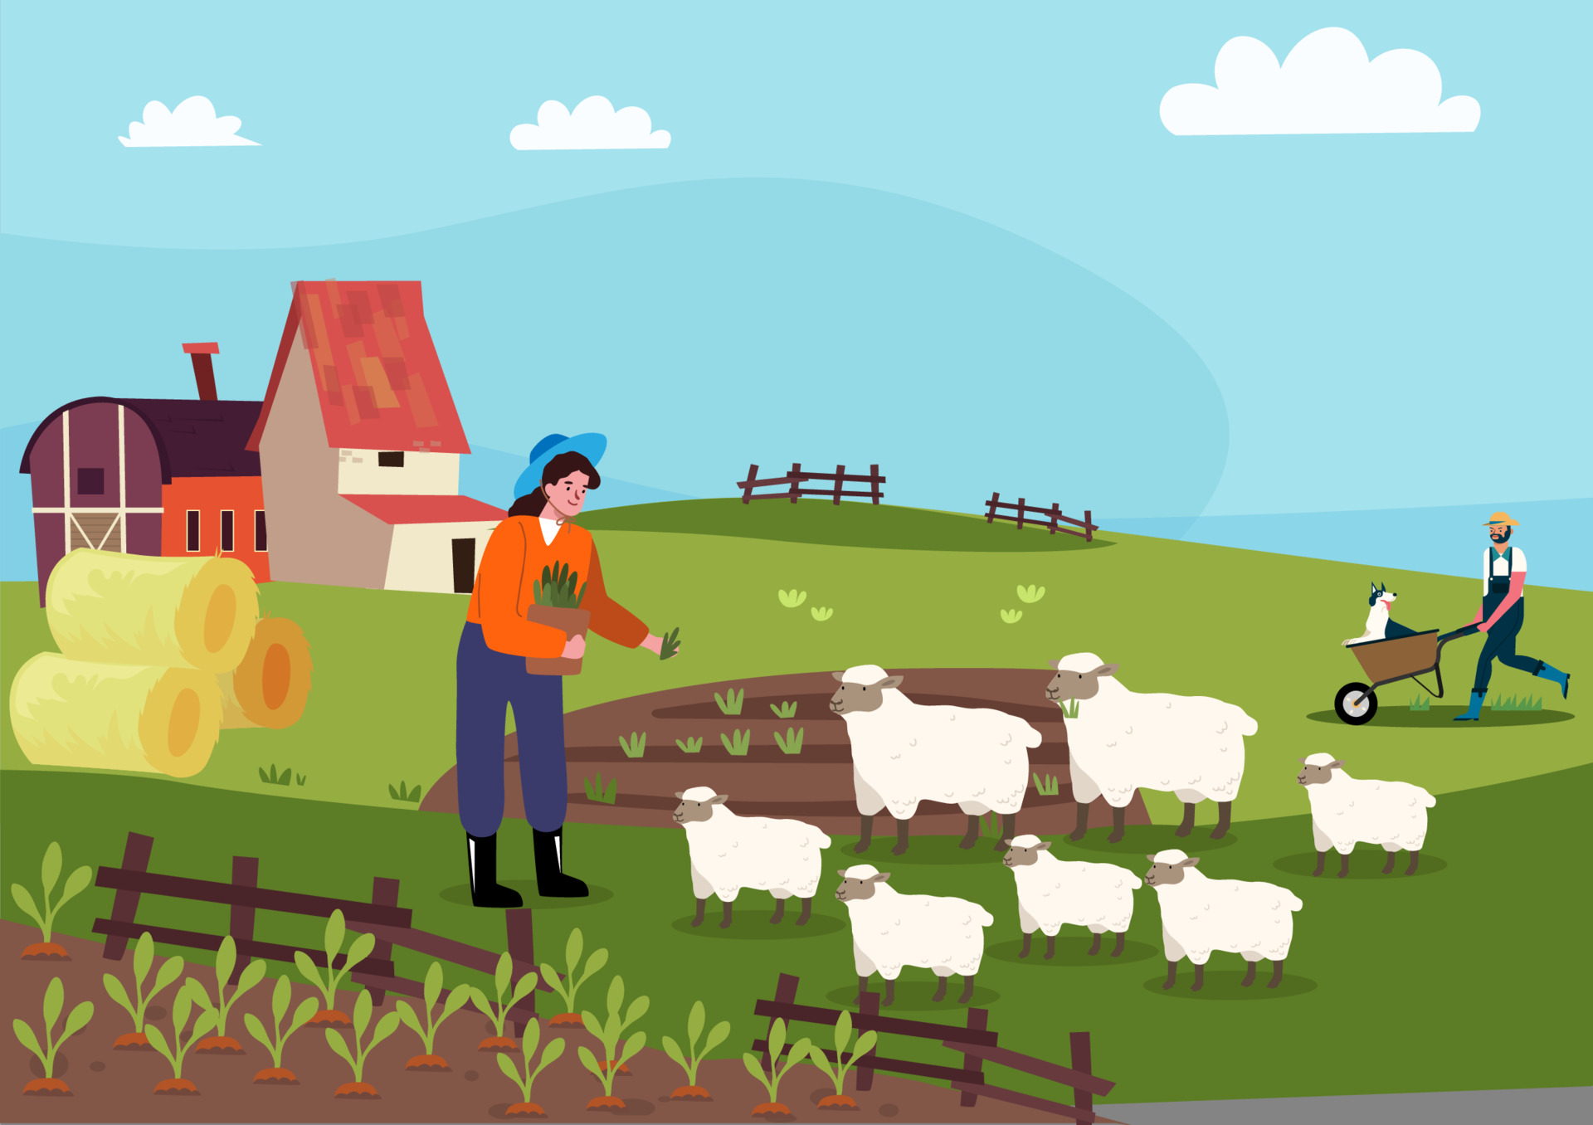





Trippr
A fun tool to assist your travel decision
Designed By:
Juanita, Tanav, Bryan, Keith, Eve

Slide 2
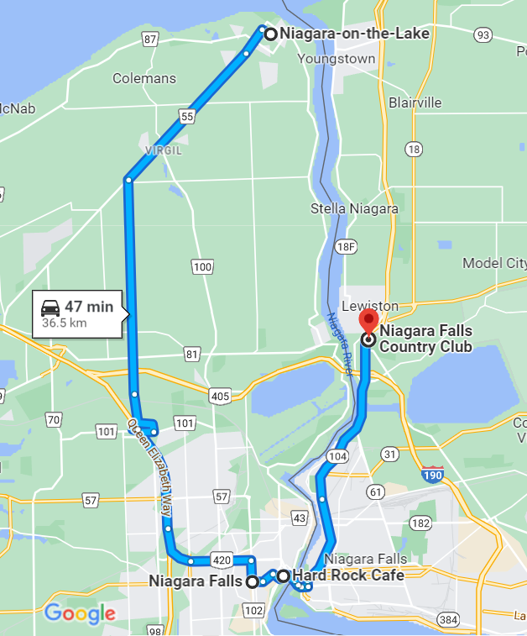



What is Trippr
What you will get (Example):
Tell us how you are and we tell you what is your best next stop!
- First:
Tell us about yourself and where you will be.
- Second:
Trippr will give you Top 3 recommendations nearby.
- Last, but not the least:
Tell us which of the 3 your are more excited about!
Stop
Make your way to great pictures at Niagara Falls
Stop
Grab an amazing Burger and Fries at Hard Rock Café
Stop
Wrap your day with a Golf Game at the Niagara Falls Country Club
1
2
3
3
1
2

Slide 3


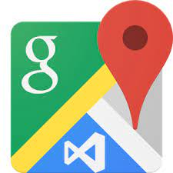





Resources and Technologies
Resources:
Google Rating Data
User inputs
Kaggle
Technologies:

Slide 4
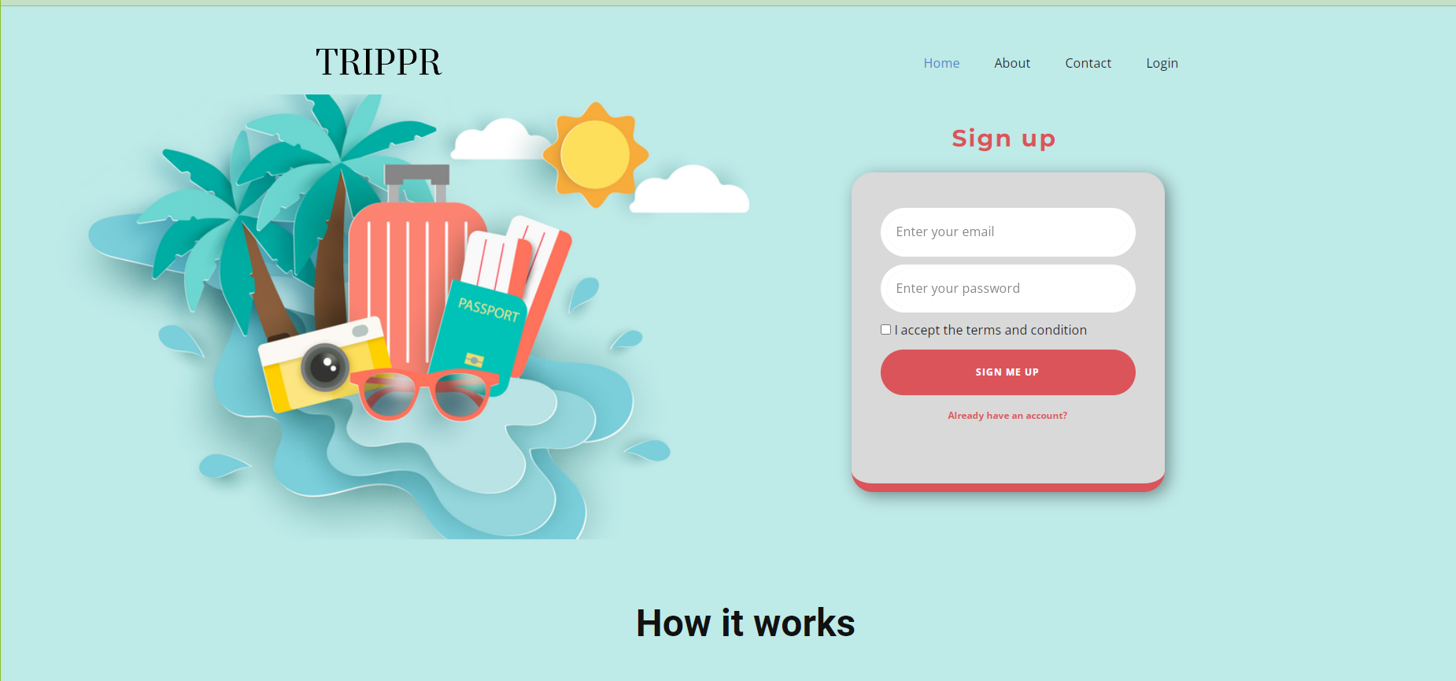
Visualization – Front Page

Slide 5
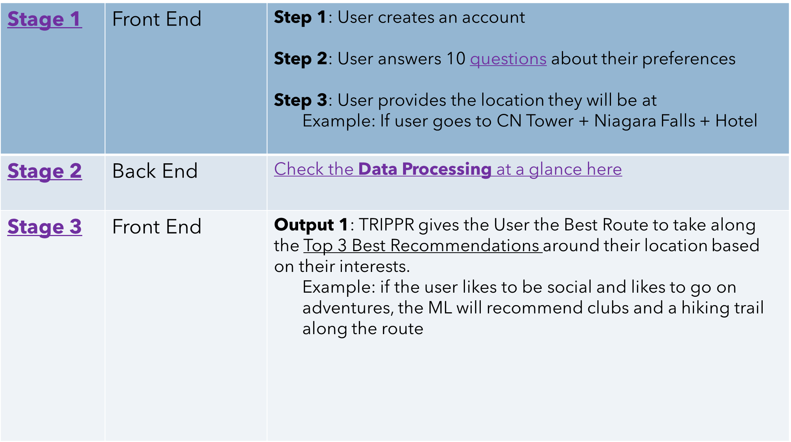
Process at a Glance

Slide 6







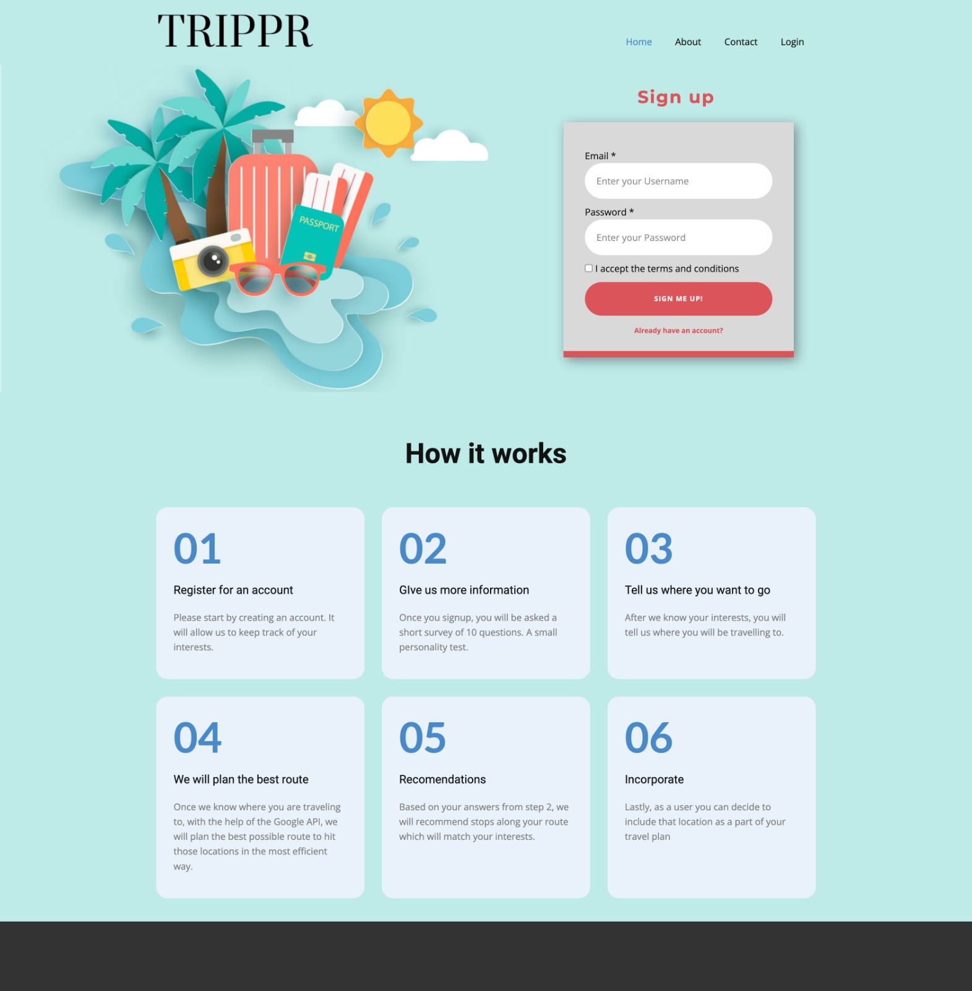
Process Flow and Diagram
Initial Unsupervised Model – run one time only for now
Training Initial rating Data for cluster
isolated model and only run it when it’s necessary
Recommendation Engine –
Get 3 winning categories based on ClusterAvgWeigting
Calculate 3 locations
Push 3 locations to JS (Flask)
HTML
Input - User Registration
Input - User survey
Output - Gmap
Output - Recommendation
Research
HTML
Project Planning
Brain Storming
Research
Process Design
Data Download
ETL & Data Store
Data Profiling
Database Design
Load to DB
Data Store
Collect User Info
Store in database

Slide 7
ML Model Diagram
Unsupervised ML Model
Data Preparation
Input
Scaling
Output
Google Rating Data
PCA Setting
Group data into clusters
Find the best value for K
Plot data and Validation

Slide 8
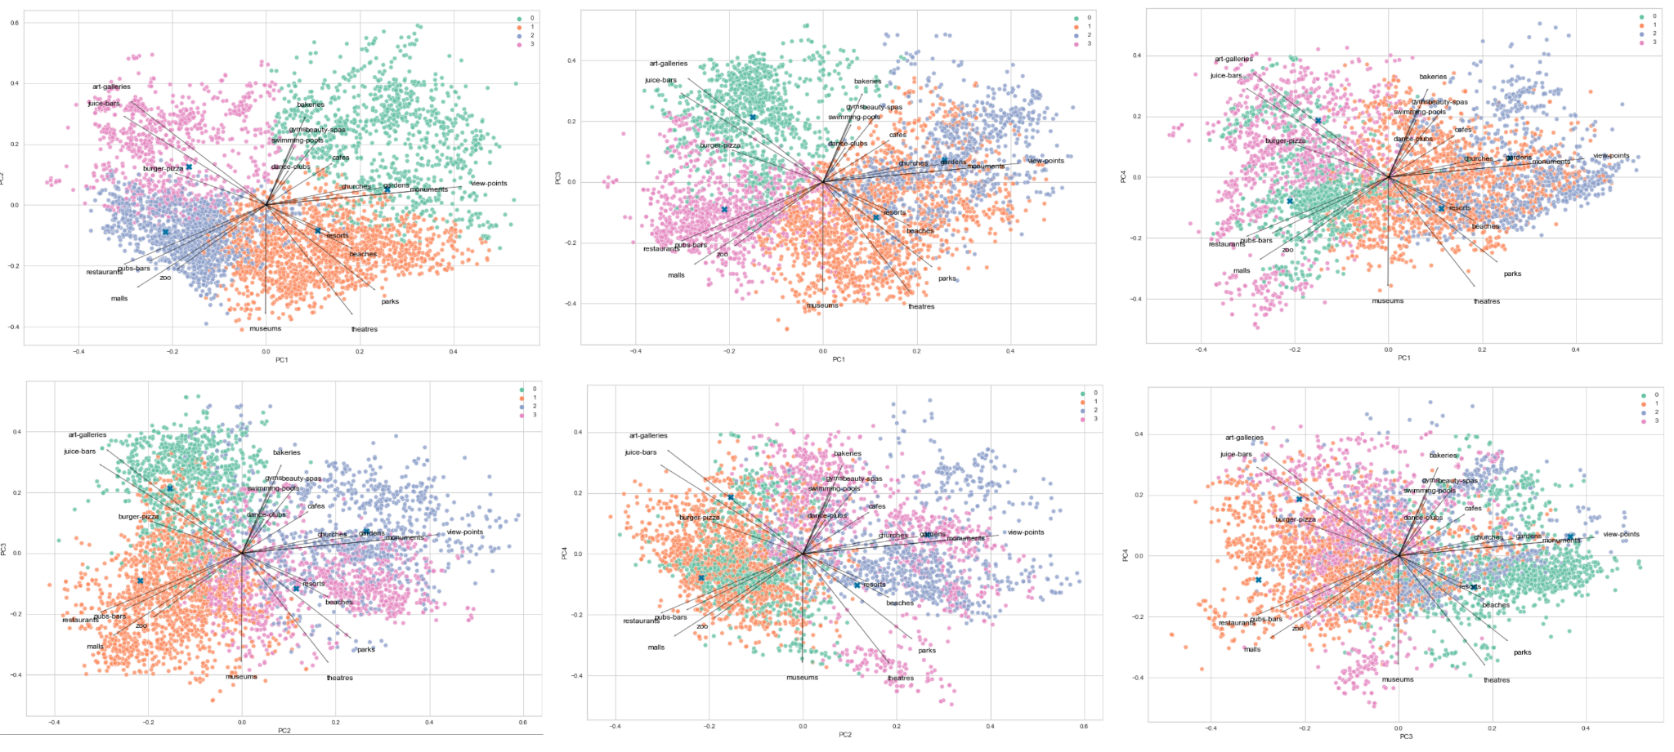
Clusters Review

Slide 9
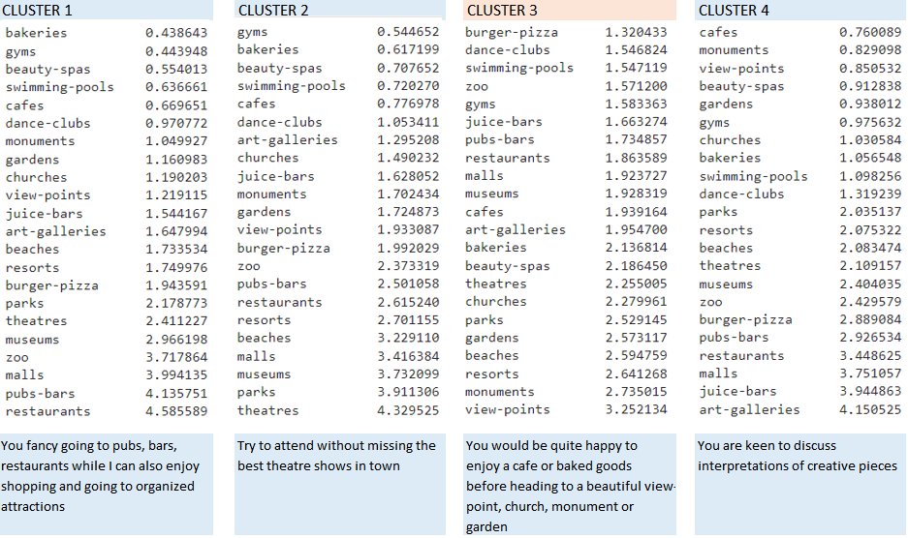
Clusters Analysis

Slide 10
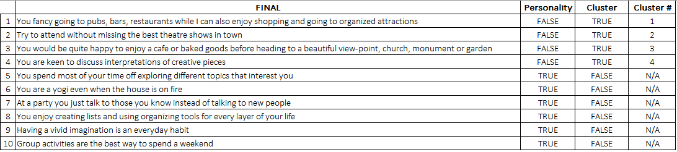
User Questions
In a scale from 1 (less like you) to 5 (more like you) answer the following 10 questions:

Slide 11
Recommendation Methodology
Inputs
(From user)
Cluster Rating
Analysis
ClusterAvgWeighting
User Cluster Define
HTML
Navigation
Category Weighting
(3 Category groups)
Random function
Place API search (3 locations)
Return top 1 result per chosen category
Outputs (3 Categories)
Top category in each group

Slide 12
SHOW TIME
Let’s go to Trippr

Slide 13
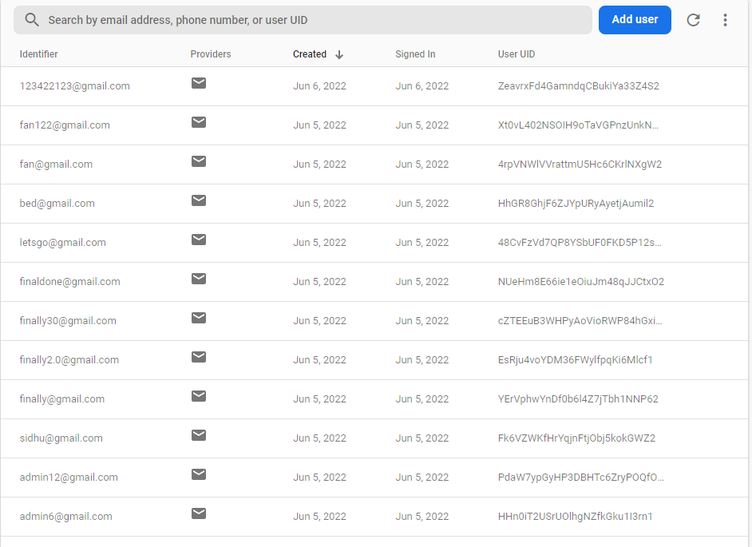
Why Firebase
Advantages:
Cloud-based NoSQL
Data Stored as JSON
Realtime to users
Build-in GUI and Security
Up to 1GB for free
Great for Apple, Android and Web app.
Disadvantages:
Hard to convert relational database

Slide 14
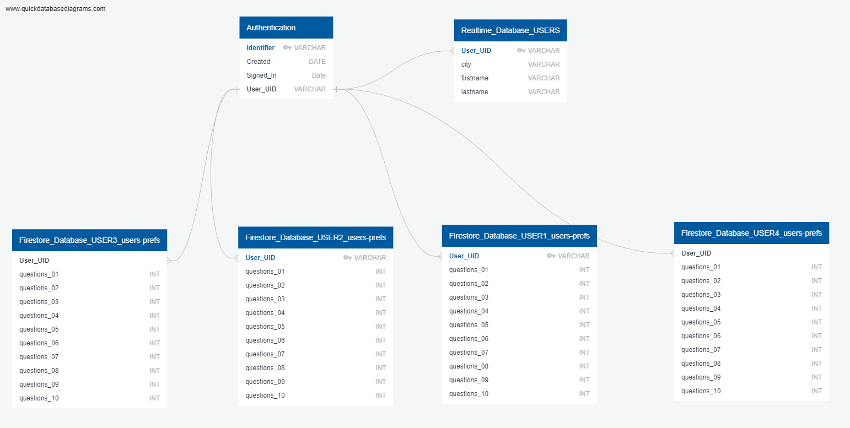
Firebase ERD
Table
Table
Collections – each user is a collection, each collection can have multiple tables
Table
Table
Table
Table

Slide 15
Improvements to place search: Improve on radius search Offer multiple sets of trip suggestions Save users' trip selections and reintegrate their decisions (reclustering/re-weighting) Improvements to initial cluster assignment: Ways to make this more dynamic or complex Improve onboarding questionnaire eg. tree of general Qs then more cluster-specific questions (multi-classification model); semantic models and relationship to cluster categories
Improve onboarding questionnaire
Conclusion
Our Challenges:
Limited data sources with user information
languages and technologies integration
New tools implementation – Firebase and Pyscript
Future Improvements:
Improvement on radius search which can be a user input
Multiple sets of trip suggestions
Optimization by adding cluster related and personality related questions
Enhancement by applying a user recommendation model

Slide 16
Thank you
Have a nice Trippr
By: Juanita, Tanav, Bryan, Keith, Eve

